Slide 1
First Order Logic
Seyed Abolghasem Mirroshandel (mirroshandel@gmail.com)
In which we notice that the world is blessed with many objects, some of which are related to other objects, and in which we endeavor to reason about them.

Slide 2
Outline
Why FOL?
Syntax and semantics of FOL
Using FOL

Slide 3
Pros and cons of
Propositional Logic
☺ Propositional logic is declarative
☺ Propositional logic allows partial/disjunctive/negated information
  (unlike most data structures and databases)
Propositional logic is compositional:
☺ Meaning in propositional logic is context-independent
  (unlike natural language, where meaning depends on context)
☹ Propositional logic has very limited expressive power
  (unlike natural language)
  E.g., cannot say “students play football or basketball“
    except by writing one sentence for each student
-meaning of B1,1  P1,2 is derived from meaning of B1,1 and of P1,2

Slide 4
First-order logic
Whereas propositional logic assumes the world contains facts,
First-order logic (like natural language) assumes the world contains
  Objects: people, houses, numbers, colors, baseball games, wars, …
  Relations: red, round, prime, brother of, bigger than, part of, comes between, …
  Functions: father of, best friend, one more than, plus, …

Slide 5
Syntax of FOL: Basic elements
Constants KingJohn, 2, NUS,...
Predicates Brother, >,...
Functions Sqrt, LeftLegOf,...
Variables x, y, a, b,...
Connectives ¬, ⇒, ∧, ∨, ⇔
Equality =
Quantifiers ∀, ∃

Slide 6
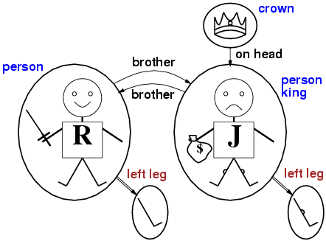
Models for FOL: Example

Slide 7
Universal quantification
∀<variables> <sentence>
Everyone at Guilan is smart:
∀x At(x, Guilan ) ⇒ Smart(x)
Roughly speaking, equivalent to the conjunction of instantiations of P
    At(P1, Azahra) ⇒ Smart(P1)
    ∧ At(P2, Azahra) ⇒ Smart(P2)
    ∧ At(P3, Azahra) ⇒ Smart(P3)
    ∧ ...

Slide 8
Existential quantification
∃<variables> <sentence>
Someone at Guilan is smart:
∃x At(x, Guilan) ∧ Smart(x)
Roughly speaking, equivalent to the disjunction of instantiations of P
  At(P1, Guilan) ∧ Smart(P1)
  ∨ At(P2, Guilan) ∧ Smart(P2)
  ∨ At(P3, Guilan) ∧ Smart(P3)
  ∨ ...

Slide 9
Properties of quantifiers
∀x ∀y is the same as ∀y ∀x
∃x ∃y is the same as ∃y ∃x
∃x ∀y is not the same as ∀y ∃x
∃x ∀y Loves(x,y)
  “There is a person who loves everyone in the world”
∀y ∃x Loves(x,y)
  “Everyone in the world is loved by at least one person”
Quantifier duality: each can be expressed using the other
∀x Likes(x,IceCream) ¬∃x ¬Likes(x,IceCream)
∃x Likes(x,Broccoli) ¬∀x ¬Likes(x,Broccoli)

Slide 10
Using FOL
The kinship domain:
Brothers are siblings
  ∀x,y Brother(x,y) ⇒ Sibling(x,y)
One's mother is one's female parent
  ∀m,c Mother(c) = m ⇔ (Female(m) ∧ Parent(m,c))
“Sibling” is symmetric
  ∀x,y Sibling(x,y) ⇔ Sibling(y,x)

Slide 11
Summary
First-order logic:
  objects and relations are semantic primitives
  syntax: constants, functions, predicates, equality, quantifiers

